Slide 1

AN APPLICATION OF THE UNSCENTED KALMAN FILTER FOR SPACECRAFT ATTITUDE ESTIMATION ON REAL AND SIMULATED LIGHT CURVE DATA
Kent Rush

Slide 2
Introduction and Background

Slide 3
Introduction
This thesis attempts to estimate the attitude and angular velocities of earth orbiting objects using light curve data
Light curve data is easily accessible and plentiful. Developing methods of analyzing this data opens significant opportunities for research and analysis.
The ability to estimate attitude and angular velocity of space objects is particularly useful for spacecraft and mission identification, as well as applications for debris removal.

Slide 4
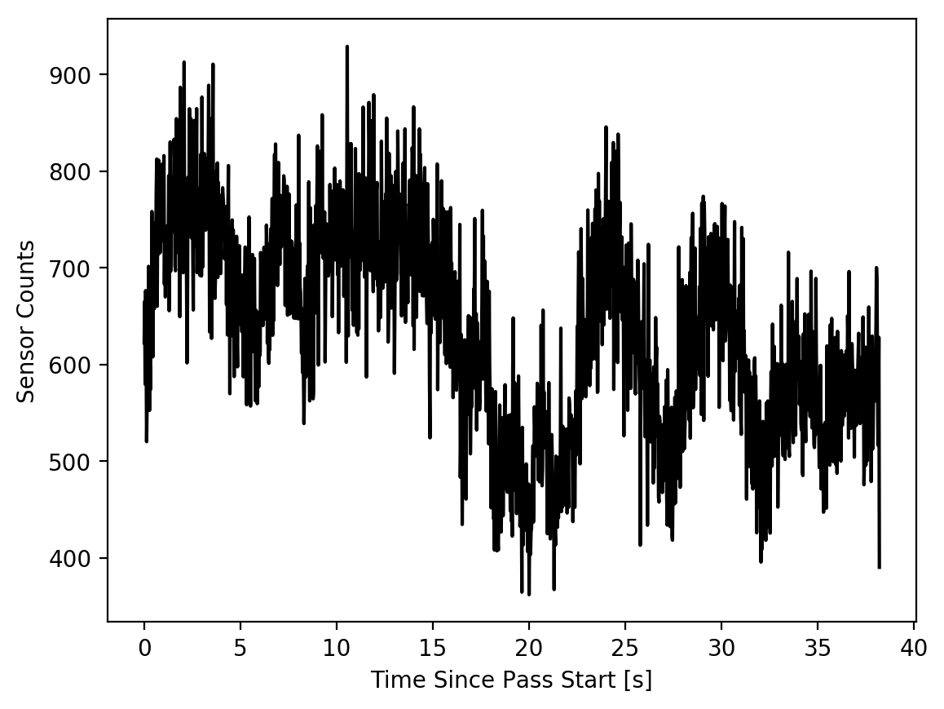
Light Curves
Data collected by observing the brightness of spacecraft as they pass overhead through a telescope
Long exposure images or rapid sequence of images
Camera CCD reports brightness as “counts” of photons
Object brightness is determined by its position, orientation, and reflectance properties
Light Curve Data from Sert-2 Spacecraft

Slide 5
Previous Work: Attitude Estimation
Attitude and Angular velocity estimation have been done before in simulation
Analysis of real data was attempted by Wetterer and Linares et al. [1][2][3]
Previous estimations of angular velocity assumed it was constant, not tumbling
Only Wetterer et al. attempted to use real data [1]

Slide 6

Indeterminacy
Solutions that recreate a light curve are not unique[4]
Any light curve can be recreated using any combination of geometry and reflectance properties [4]
It is impossible to distinguish between clockwise and counterclockwise rotation when the object is unresolved[4]

Slide 7
Kalman Filtering
A statistical method which combines a dynamic model and real measurements of a system to estimate its state.
Essentially finds the state that most accurately predicts the next measurement.
Requires a model of the system dynamics and of the measurement system.

Slide 8
Brief nomenclature
Frame – A set of coordinate axes in which vectors are expressed
ECI – Earth Centered Inertial frame which does not rotate or accelerate
Body Frame – A frame in which object features are defined
UKF – Unscented Kalman Filter
Inertia matrix – A 3x3 matrix which describes the distribution of mass of an object. Used to propagate the rotation of rigid bodies

Slide 9
Motivation and Project Definition

Slide 10

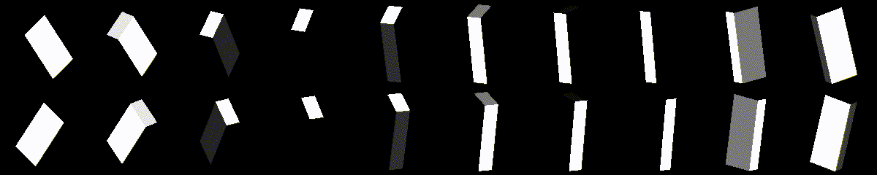
Project Definition
Estimate the attitude and angular velocity of real and simulated objects using an Unscented Kalman Filter
Develop two Kalman Filter formulations for tumbling and non-tumbling objects.
Investigate the effects of symmetry on converged solutions

Slide 11
Potential Applications of Attitude Determination from Light Curves
Debris Removal
National Security
Operations
How fast is this spacecraft spinning?
In what way is this spacecraft spinning?
Is this spacecraft pointing at targets of significance to national security?
Is my spacecraft behaving as expected?
Is my spacecraft under control?

Slide 12
Methodology

Slide 13
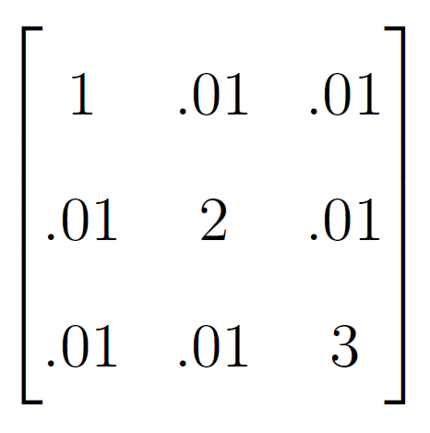
Kalman Filter Formulations
State estimates Modified Rodriguez Parameters and angular velocity.
For tumbling objects inertial properties are also estimated
Dynamic model is Eulers Equations of Motion
Measurement model is a combination of a Phong BRDF and Ray Tracing. [5][6]

Slide 14
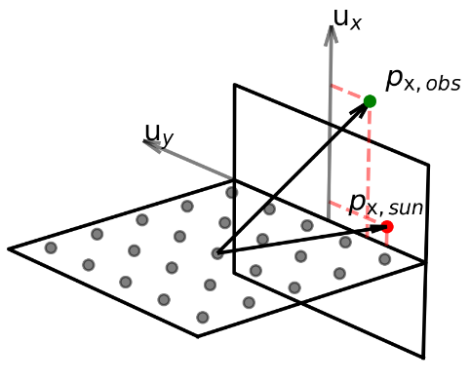

Measurement Model
“Ray Tracing” [5]
Phong BRDF [6]
Algorithm
Obeys conservation of energy
Accurately models decreasing diffuse component as incident angle decreases
Calculate the percentage of each facet that is not occluded
Apply the Phong BRDF model for the reflectance of each facet accounting for occlusion
Breaks up each facet into multiple small facets
Calculates the occlusion for each sub-facet given sun vector and observation vector.

Slide 15
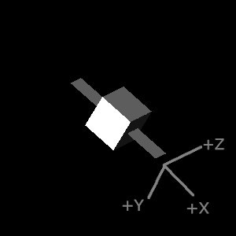
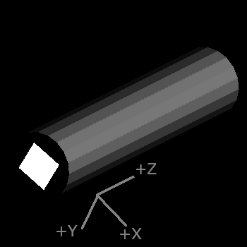
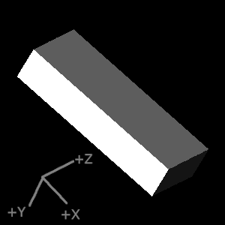
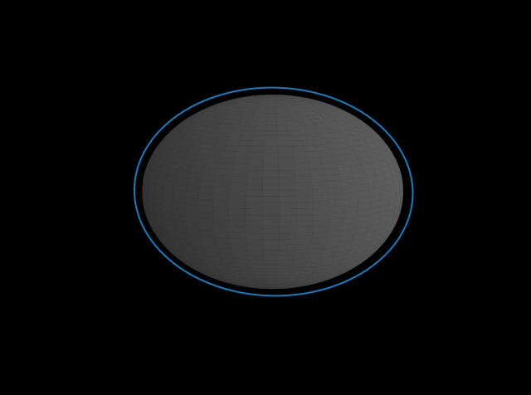
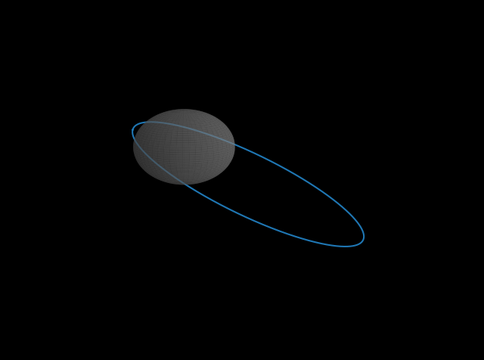
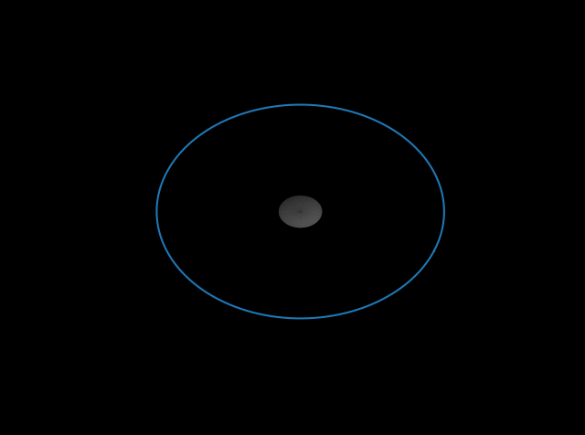
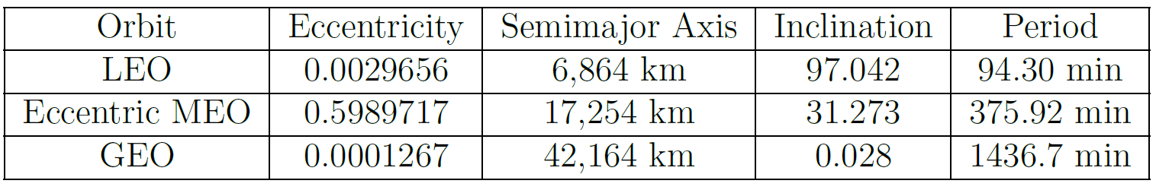
Simulated Data
Data was generated for various geometries across various orbits sampled over the course of a year.
Initial attitude was randomized
Data was discarded if the angle between the observer and sun was larger than 90 degrees

Slide 16
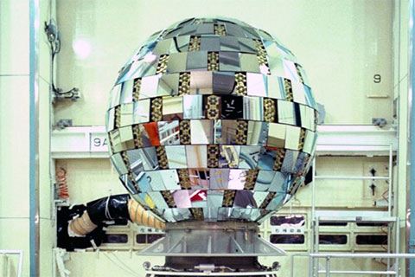
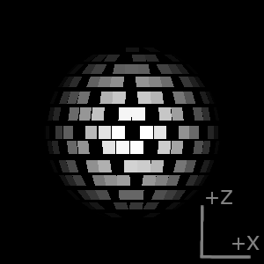
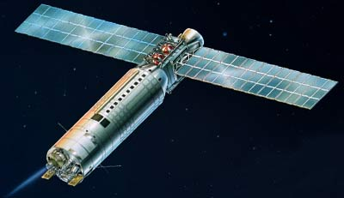
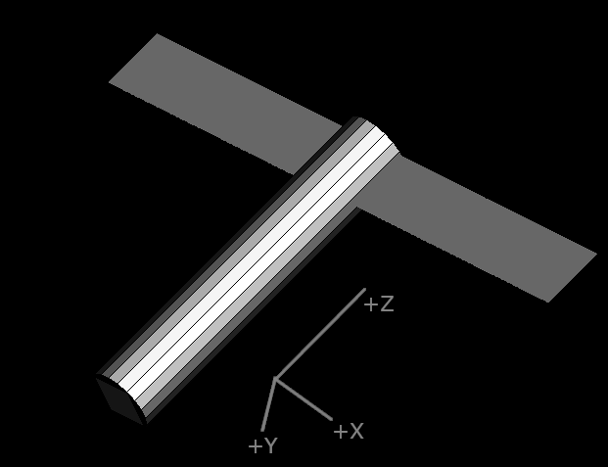
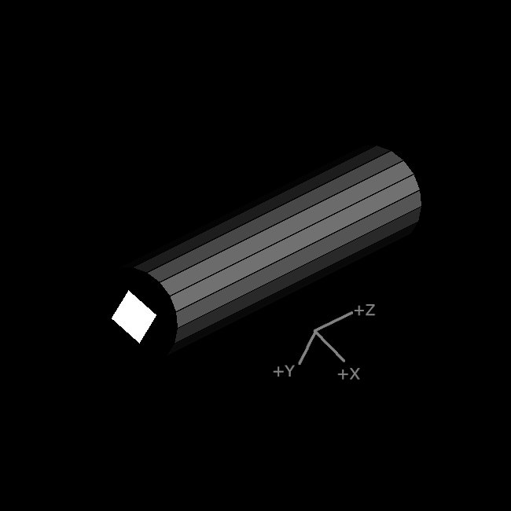
Real Data
Real data was provided by Lockheed Martin Space
These objects were selected due to their unique geometries and quality of data
The Kalman Filter applied to real data was tuned and verified on simulated data and then applied to real data
Ajisai (EGS)
Sert-2
Image credit: JAXA and NASA
Ariane-40 Rocket Body

Slide 17
Symmetrical solutions
After processing all the simulated trials, the results were searched for instances of alternative, symmetrical solutions

Slide 18
Validation

Slide 19
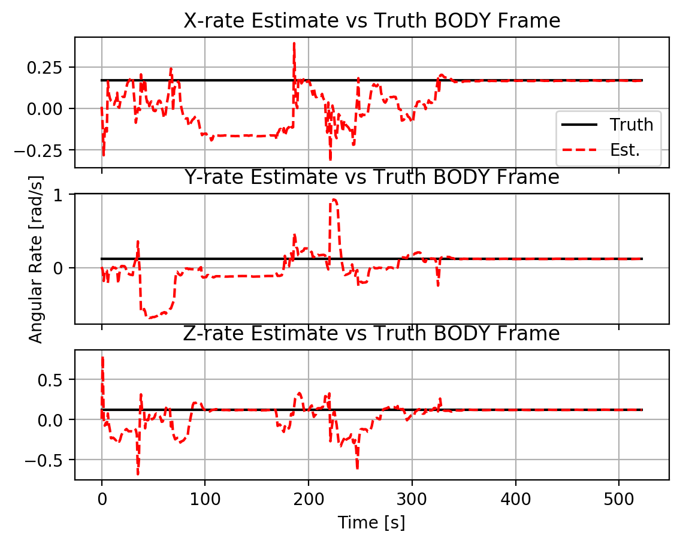
Convergence Criteria
Convergence of the Kalman Filter was determined by observing the updates to the state estimate
For the non-tumbling case, convergence was determined if the size of the updates to angular velocity were less than 1e-4 radians/second
For the tumbling case this was increased to 2e-3

Slide 20
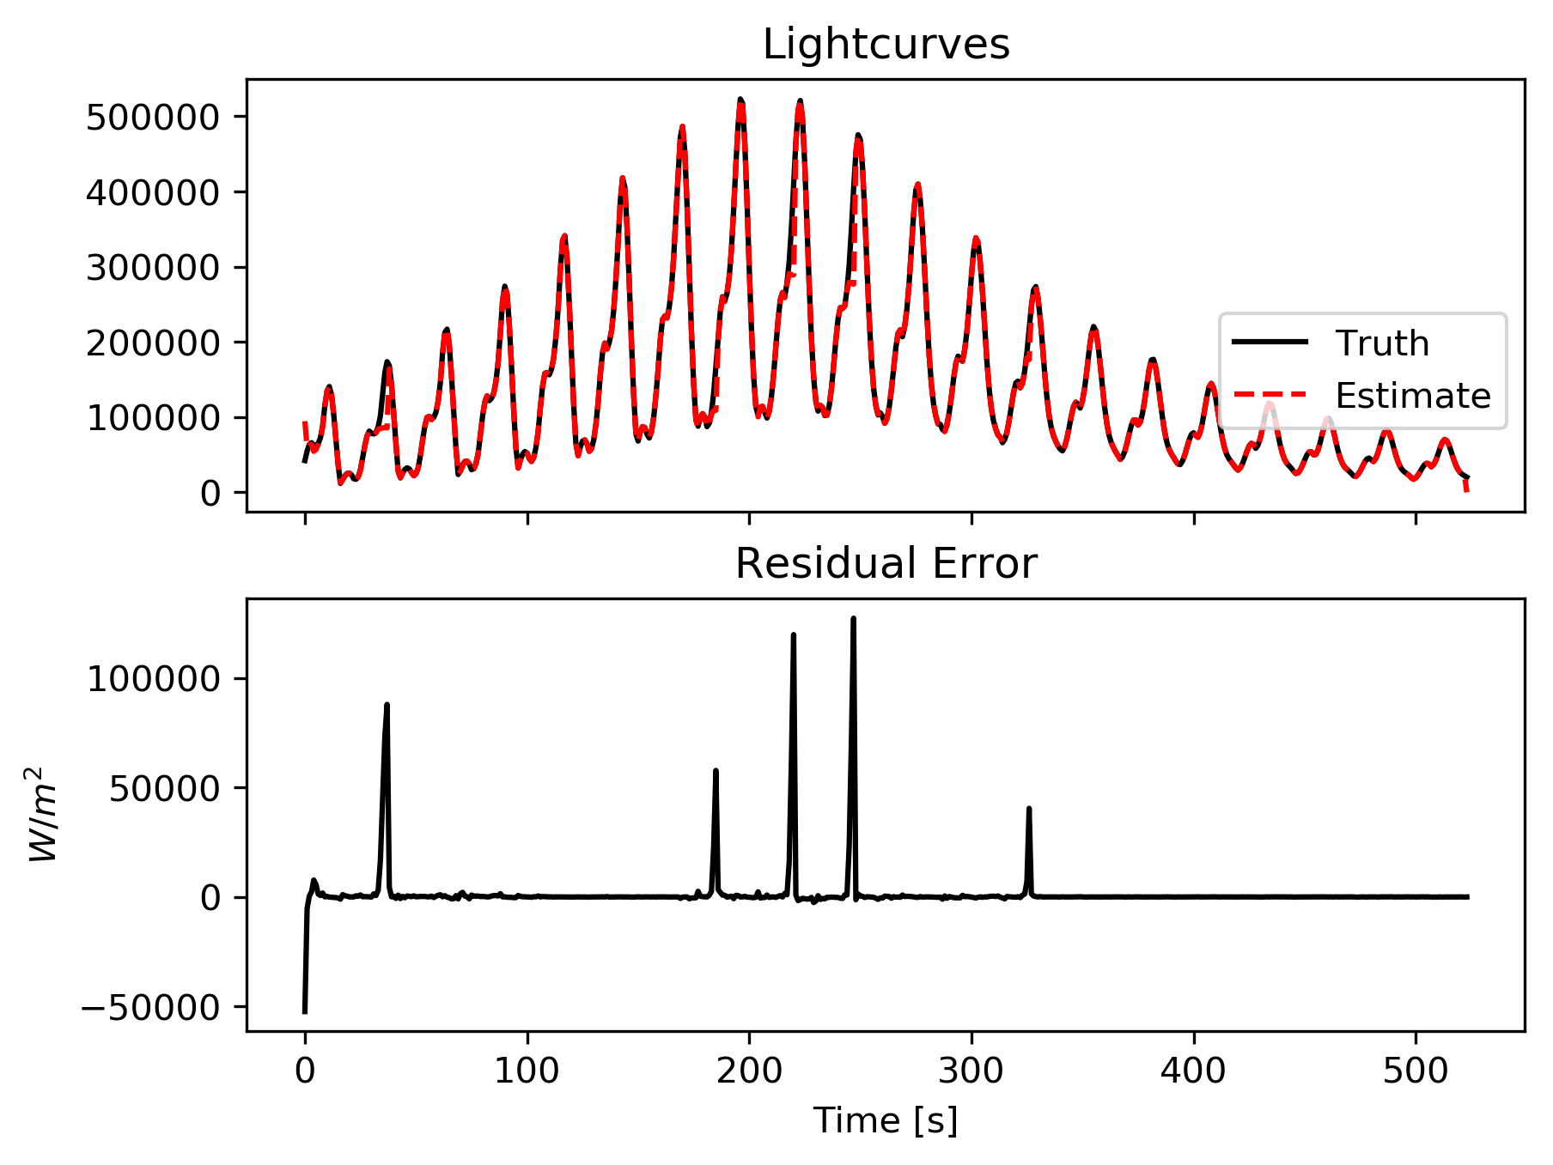
Residual Error
Once a solution was converged, its validity was evaluated by how well it fit the data
The light curve predicted by the state estimate was subtracted from the data
This residual is expected to converge near zero for a valid solution

Slide 21
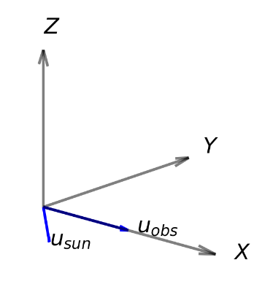
Symmetrical solutions
A solution was said to be symmetrical if the Z component of the angular velocity was the negative of the truth in the OBSERVATION frame
The observation frame is defined to have its XY plane coplanar to the sun and observation vectors. The Z axis completes the frame
Definition of the Observation Frame

Slide 22
Results and Analysis

Slide 23
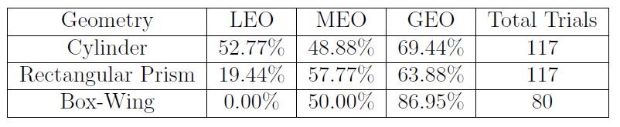
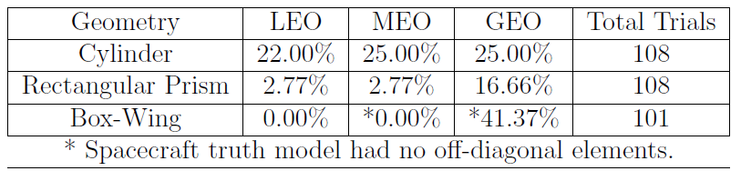
Simulation Results
MEO and GEO orbits seem to perform significantly better
Tumbling case performed significantly worse
Most solutions did not match the truth in any frame, but were valid solutions
Non-Tumbling Case Success %
Tumbling Case Success %
Notes:
Why did meo and geo perform better, why did tumbling perform better than non tumbling

Slide 24
Attempt to Reduce Solutions
Each face of rectangular geometry in GEO was given unique properties
This significantly increased the success rate to 83% from 63%
However, only 1 in 36 converged to the truth

Slide 25
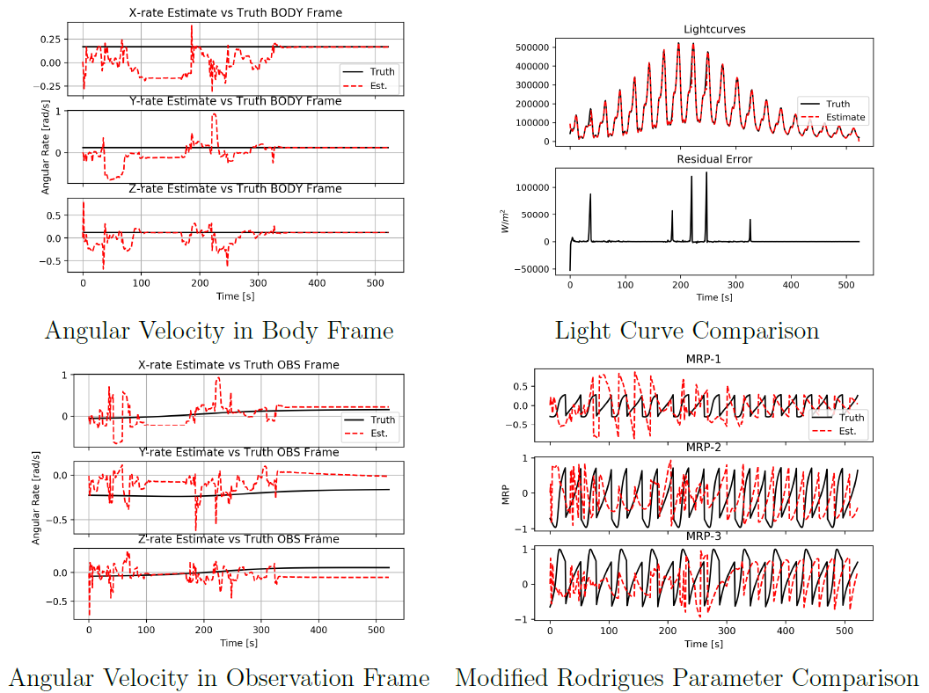
Non-Tumbling Results
Rectangle, LEO, Non-Tumbling
When estimate and truth align, the match is very close
Solutions sometimes converged to the true body rate, but a different attitude
With real data, the only metric for comparison would be the light curve residual
Notes:
What we expect to see is for the angular velocity to converge to constant values and the light curve residual to drop to zero
You can see the flipping between MRP and shadow parameter

Slide 26
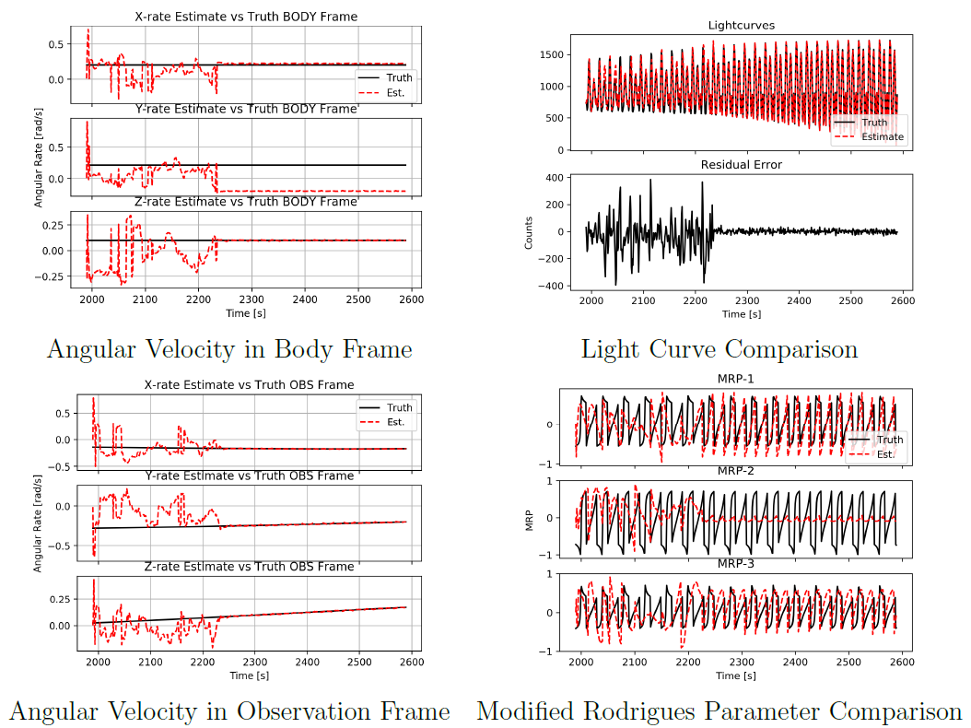
Non-Tumbling Results
Box Wing, GEO, Non-Tumbling
Angular velocity solutions can differ from the truth in body frame but match in the observation frame
This trial fit the data, but most of the state estimate differed from the truth
Notes:
What we expect to see is for the angular velocity to converge to constant values and the light curve residual to drop to zero
You can see the flipping between MRP and shadow parameter

Slide 27
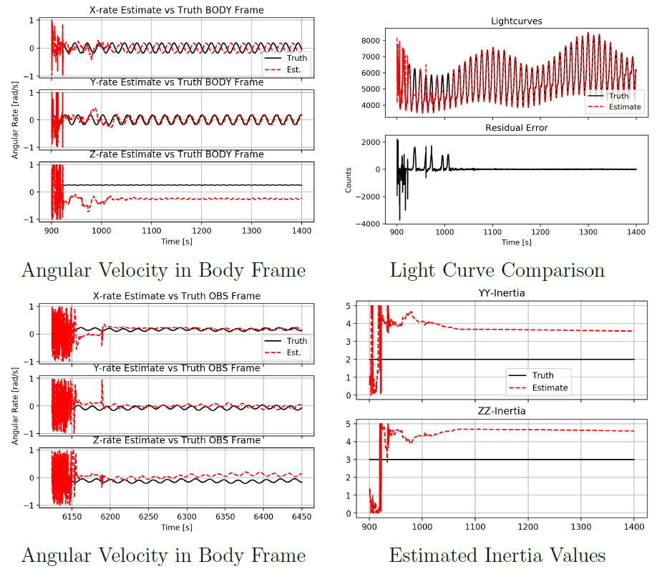
Tumbling Results
Cylinder, MEO, Tumbling
No result converged in either body or observation frame
Inertia estimates converged to constant values, but the inertial ratios varied wildly
Struggled to converge due to unmodeled, off-diagonal inertia elements

Slide 28
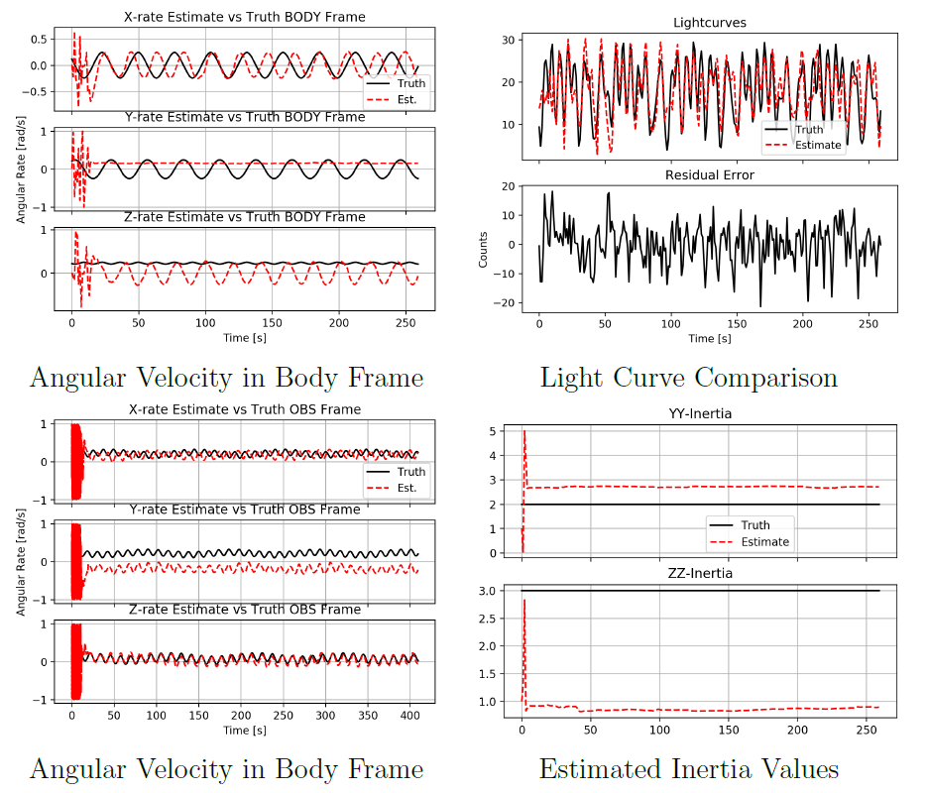
Tumbling Results
Box Wing, GEO, Tumbling
In one instance, a solution converged to a local minimum
Angular velocity seemingly in a 4:5 resonance with the truth
This would be detectable in practice as the residual is not minimized

Slide 29
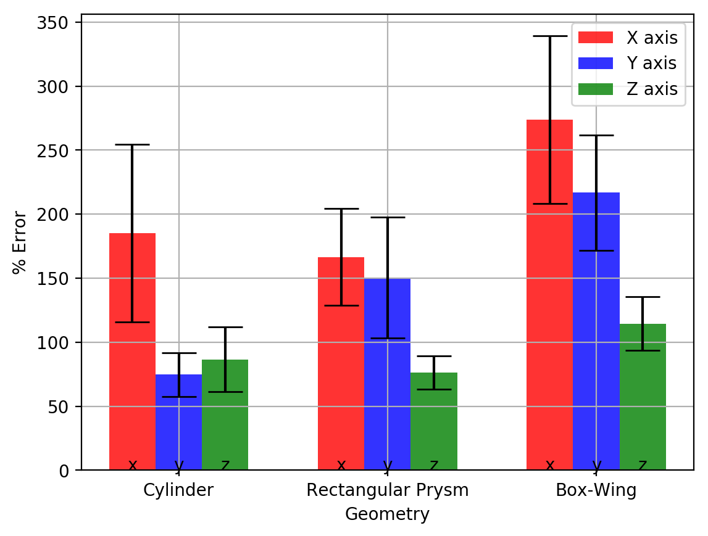
Analyzing Performance
Direct Error Comparison in ECI Frame
Error and variance was analyzed for the non-tumbling trials
Direct comparison of the estimated state and the true state yields meaningless results
Valid solutions which converged to an alternate solution than the truth had to be filtered out

Slide 30
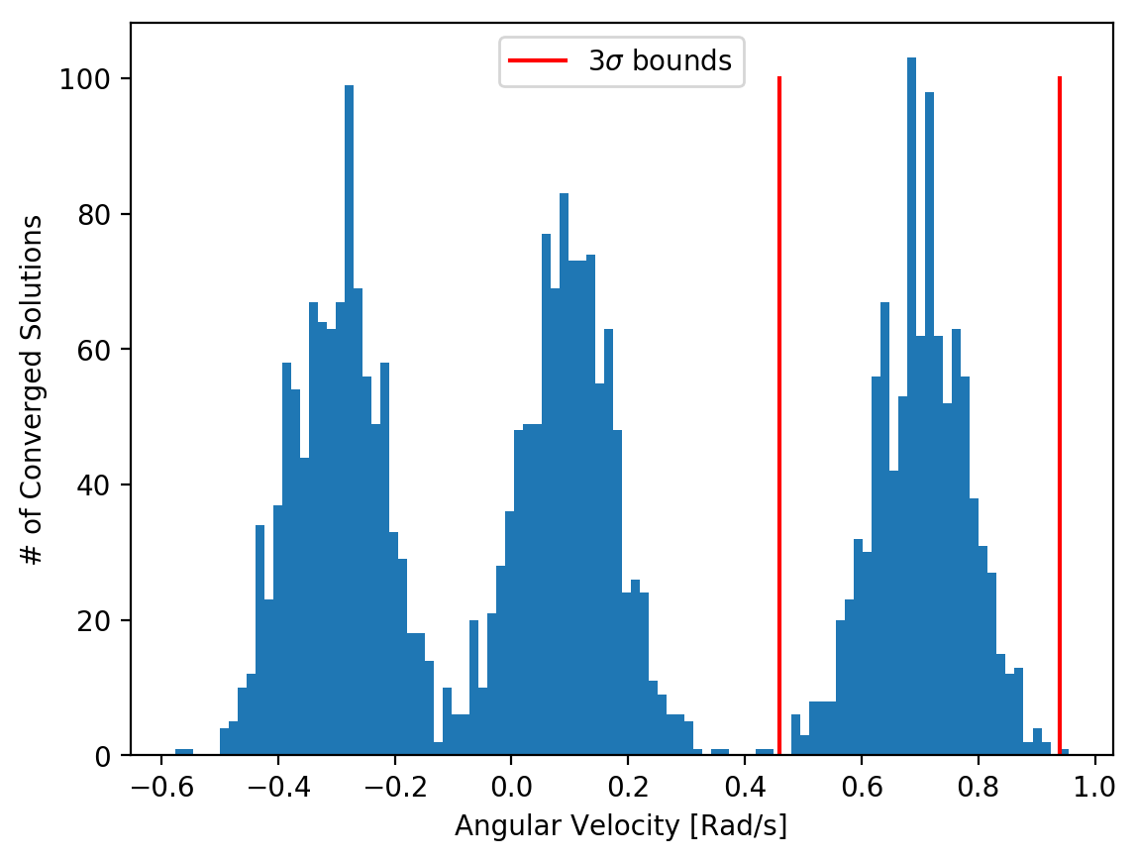
Analyzing Performance
Hypothetical Result Distribution for a Single Axis
The mean variance for converged results was used as a filter to identify solutions converging to the truth model
Filter assumes that solutions have distinct means

Slide 31
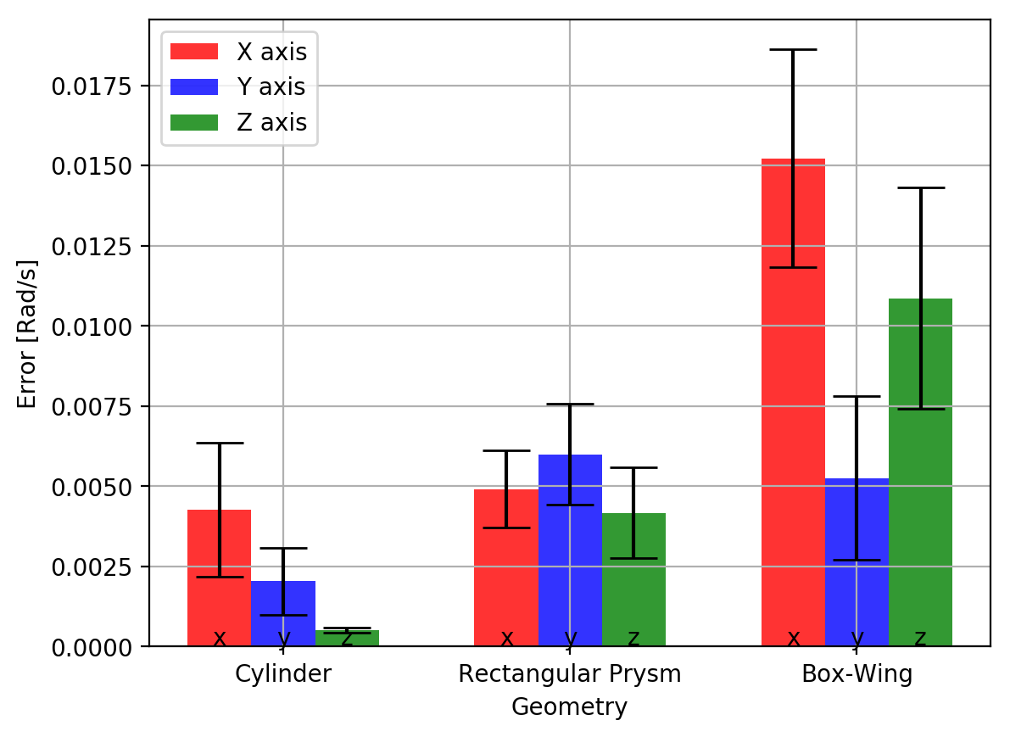
Effects of Geometry
Angular Velocity Error by Body Axis
Each geometry showed distinct differences in performance in relation to their geometry
The cylinder performed unexpectedly well along its Z axis
The box-wing geometry showed the largest errors likely due to its relatively low brightness

Slide 32
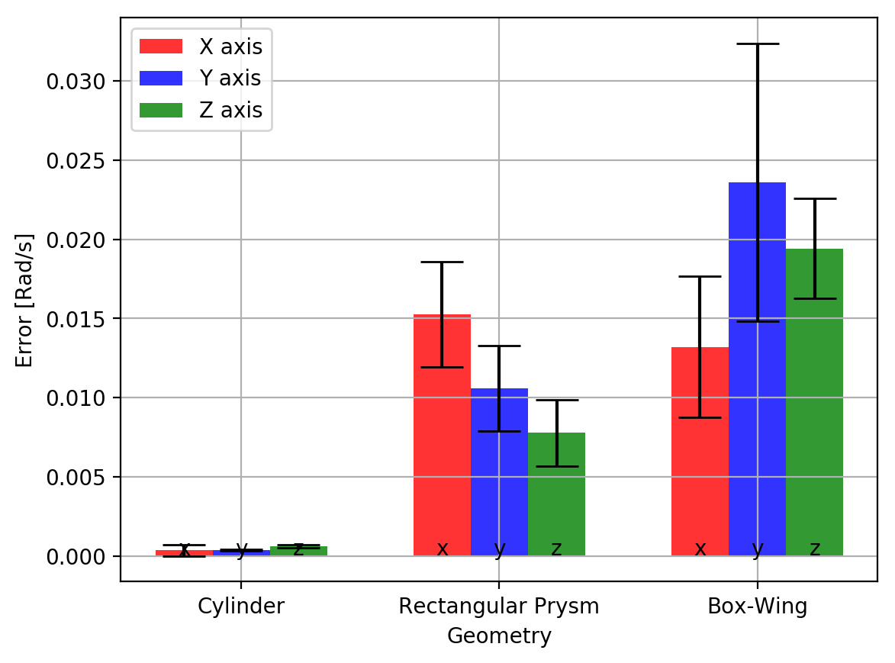
Tumbling Solutions
Angular Velocity Error by Observation Frame Axis
No clear distinction between axes
Cylinder performed significantly better, likely due to the decoupling of attitude from performance along Z axis
Errors typically increase because of the addition of attitude error

Slide 33
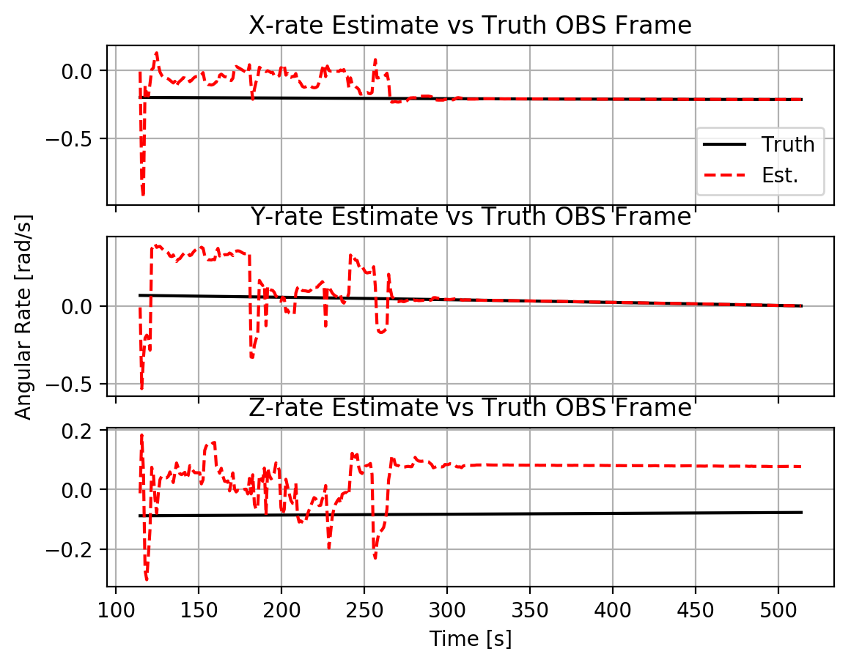
Symmetrical Solutions
6 out of 314 trials converged to symmetrical solutions.
Easily identifiable in the observation frame because of the negative angular velocity along the Z axis
The existence of this relationship between solutions allows for more meaningful results to be extracted from analysis
Estimate
Truth
Notes:
Happened with both Rectangle and Cylinder

Slide 34
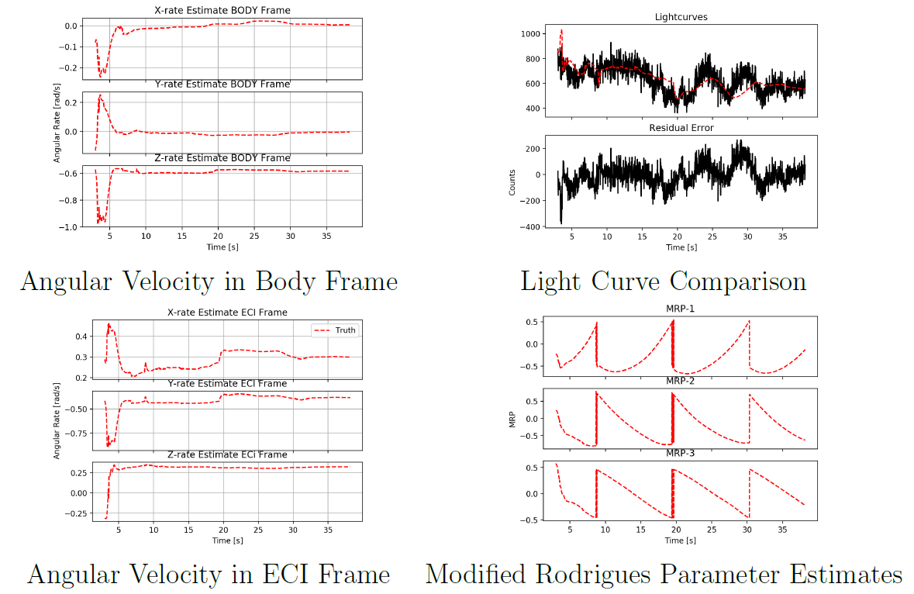

Real Data Results – Sert-2
UKF converged to a plausible result
Constant angular velocity, reduced residual less than in simulated cases
Estimated Attitude

Slide 35
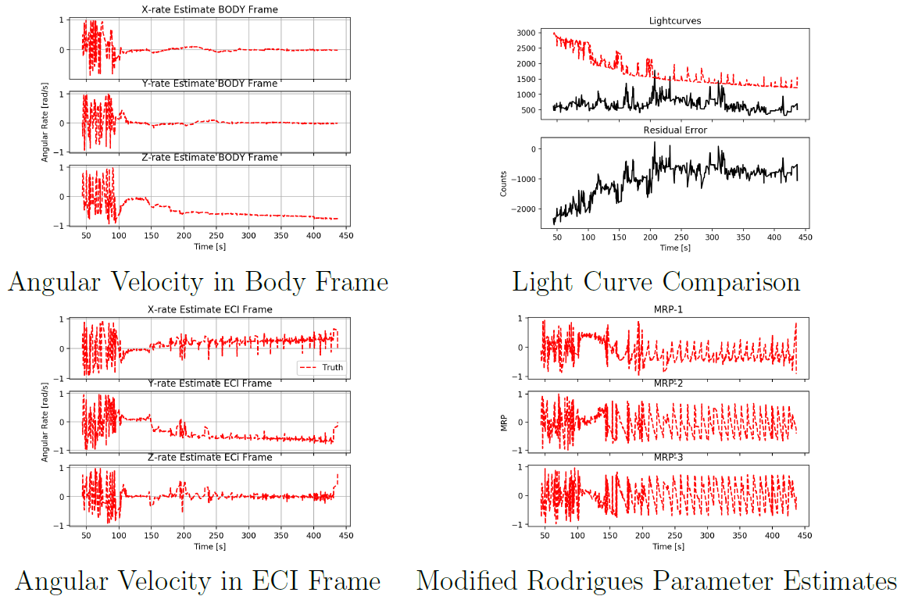
Real Data Results – Ajisai
Converged solution did not match the data
This geometry is challenging as its brightness would change very little with attitude
Likely that reflectance properties were too large

Slide 36
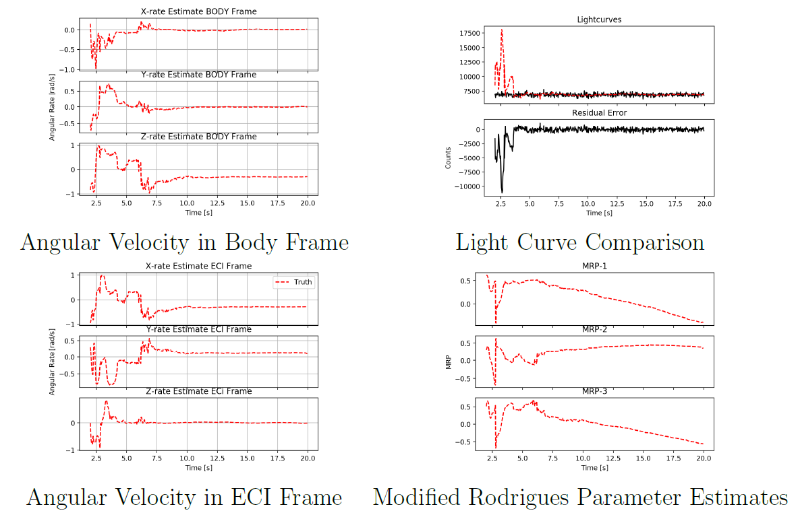
Real Data Results – Ariane-40 R/B
Converged solution matched light curve, however too much noise to observe a signal
Converged solution is not about the expected major axis

Slide 37
Conclusions

Slide 38
Is it possible to estimate states from light curves?
Tumbling Objects
Non-Tumbling Objects
Yes.
Valid results were estimated in the majority of the trials
Yes.
Performance significantly lower than non-tumbling case
The necessary complex models and additional states led to a decreased performance

Slide 39
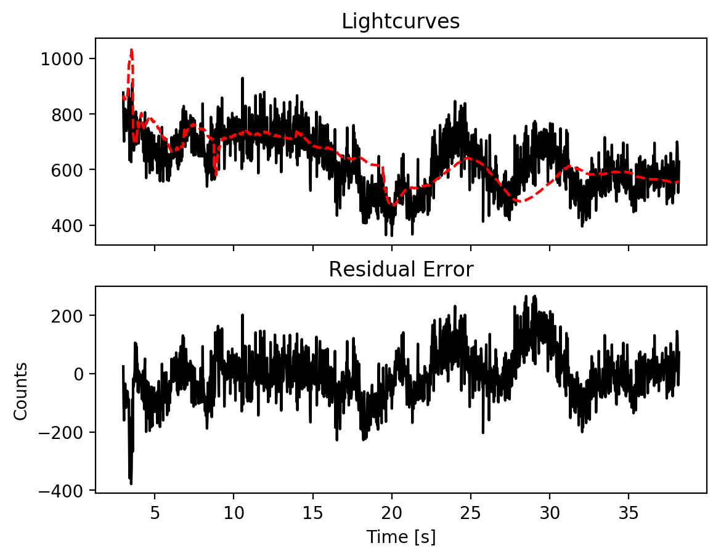
Was real data successfully analyzed?
Yes and no.
Solutions were converged to which fit the data, however the solution cannot be verified
Discrepancies between the light model and real data were noticed in the case of AJISAI.
The measured signal was often lost in the noise

Slide 40
Uniqueness of solutions
Solutions were already known to not be unique [18]
A new, predictable set of solutions has been observed and described
In addition to the direction of rotation being indeterminate, the axis of rotation can be mirrored across the plane of observation

Slide 41
When does this method work best?
Best results were obtained in higher orbits
The rapid change in amplitude of light curve data in LEO posed a challenge for the UKF
Certain body axes tend to perform better depending on the features about that axis

Slide 42
Future Work

Slide 43
Future Work
Improved Reflectance Model
UKF Improvements
A study focused on developing a robust and accurate and verified reflectance model would enable future research in this area to produce more confident results and enable more serious analysis of real data.
Faster language: C/C++
Telescope modeling
Atmospheric Effect Modeling
Material and Surface Parameter Validation
Reformulations of the UKFs proposed here could produce better results. Potential modification for improvement could be as follows:
Inclusion of off-diagonal inertia terms to state
Include surface optical properties as elements of the state to be optimized

Slide 44
Future Work
Orbit Estimation
Improved Data Acquisition
TLEs were a quick, easy, and sufficient method of retrieving position data of the spacecraft in this thesis. However, positional error in the TLE may seriously impact UKF performance.
Orbit could be estimated as a state element in the Kalman filter
Orbit could be estimated in pre-processing through traditional orbit estimation techniques
It is unknown what parameters create the highest quality data for this form of light curve analysis. A dedicated investigation into obtaining high quality, low noise light curve data would significantly increase the likelihood of obtaining practically applicable results.

Slide 45
Sources

Slide 46
C. J. Wetterer and M. K. Jah. Attitude estimation from light curves. Journal of Guidance, Control, and Dynamics, 32(5):1648{1651, 2009.
R. Linares, M. K. Jah, J. L. Crassidis, F. A. Leve, and T. Kelecy. Astrometric and photometric data fusion for inactive space object mass and area estimation. Acta Astronautica, 99:1 { 15, 2014.
R. Linares, M. K. Jah, J. L. Crassidis, and C. K. Nebelecky. Space object shape characterization and tracking using light curve and angles data. Journal of Guidance, Control, and Dynamics, 37(1):13{25, 2014.
P. Magnusson, M. A. Barucci, J. D. Drummond, K. Lumme, and S. J. Ostro. Determination of pole orientations and shapes of asteroids. In R. P. Binzel, T. Gehrels, and M. S. Matthews, editors, Asteroids II, pages 67-97, Jan. 1989.
M. Kaasalainen and J. Torppa. Optimization methods for asteroid lightcurve inversion: I. shape determination. Icarus, 153:24{36, 09 2001.
M. Ashikhmin and P. Shirley. An anisotropic phong brdf model. J. Graph. Tools, 5(2):25{32, Feb. 2000.

Slide 47
Backup Slides

Slide 48
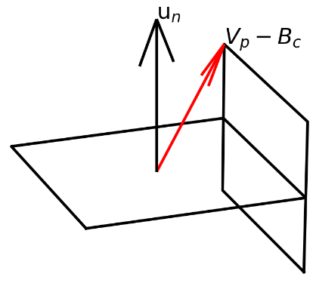
Ray Tracing Model

